Slide 1
Credit Card Management
By :
Amit Kumar
Rishabh Bajpai
Sofia Roman
Naveen Narayanappa

Slide 2

SCOPE
To build up business standards.
To monitor customer’s transaction on daily, weekly and monthly basis.
To categorize customers on transactional basis.
To personalize offering based on customer’s analysis and strategizing development of marketing campaigns to directly address customer behavior.

Slide 3
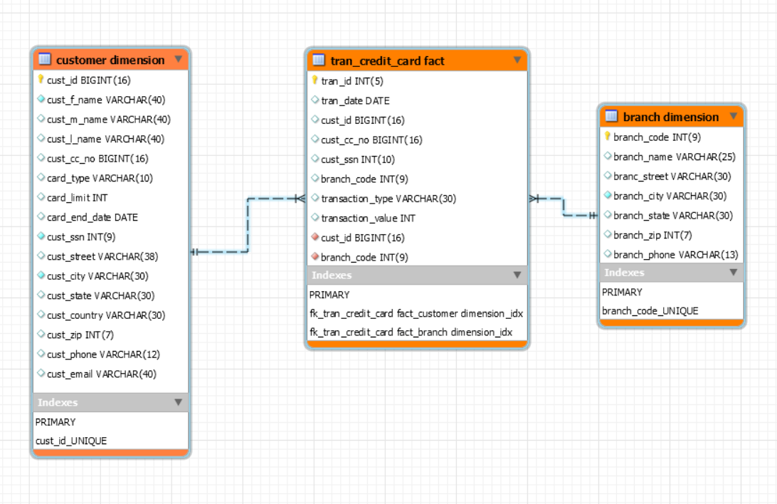
DATA WAREHOUSE SCHEMA

Slide 4



TECHNOLOGY USED
HDFS
HIVE
SPARK

Slide 5


ADVANTAGES
HDFS (Hadoop Distributed File System)
Distributed storage
Batch processing
Horizontal Scalability
HIVE
Takes very less time to write Hive query in comparison to MapReduce code
Keeps queries running fast
Simple to learn and use
Supports Partitioning and Bucketing
We can use complex data types in Hive

Slide 6
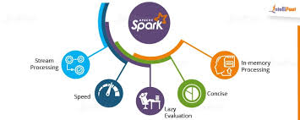
SPARK
Best processing unit in hadoop and non hadoop environment
In-memory data processing engine
Executes batch processing jobs faster than MapReduce
Supports parallel processing
Ability to handle both batch and streaming data
Can work on Stand alone or with YARN,MESOS

Slide 7

WORK FLOW
Raw Data
Loading data into HDFS
Importing the source data into hive using spark
Yes
Creating desired target tables in hive
Validate the data
No
Check the data and validate again
Processing data using spark

Slide 8
OUTPUTS

Slide 9
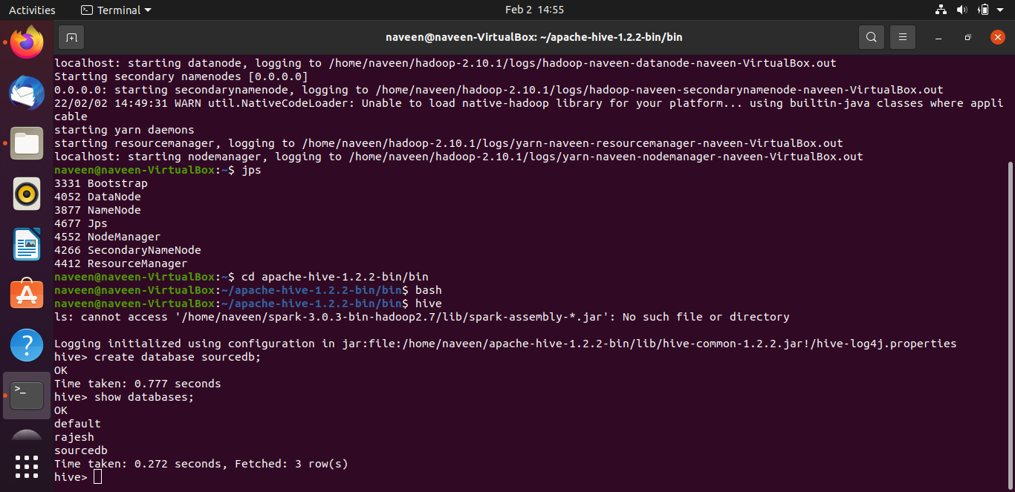
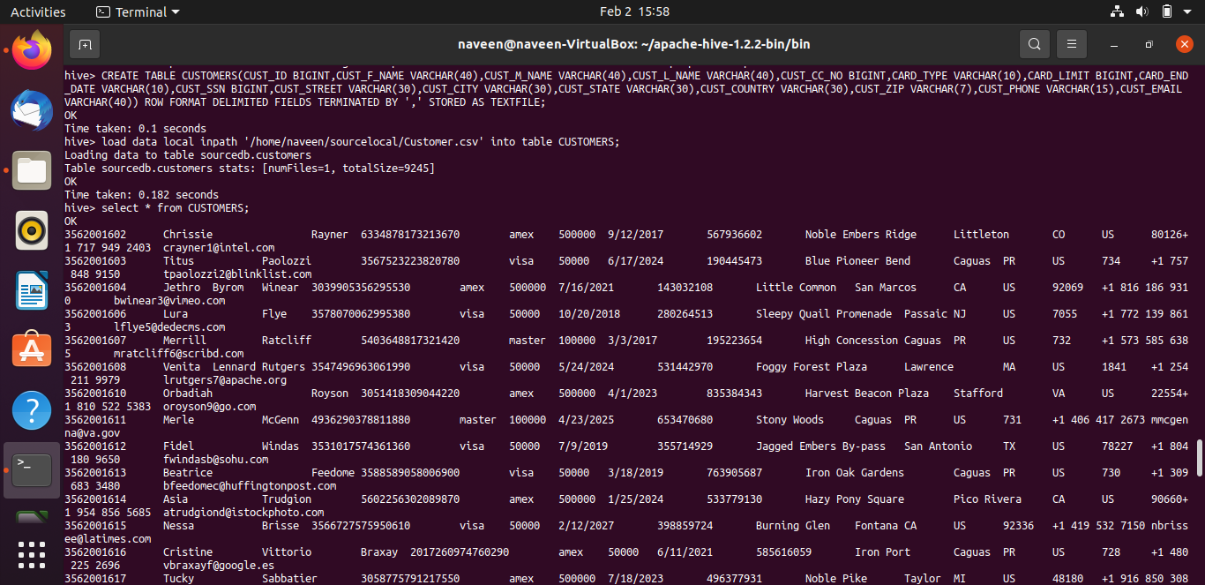

Slide 10
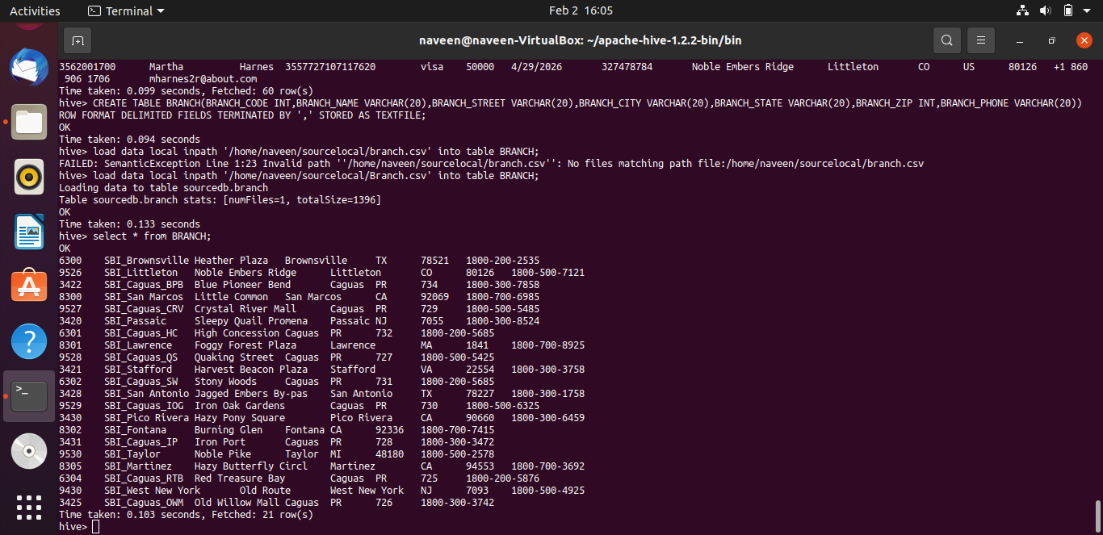
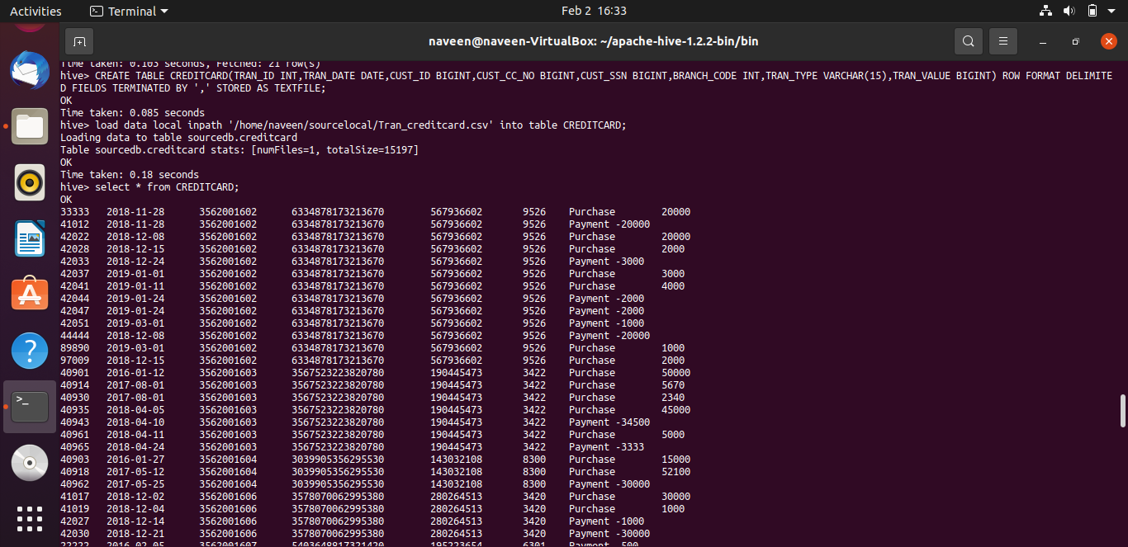

Slide 11
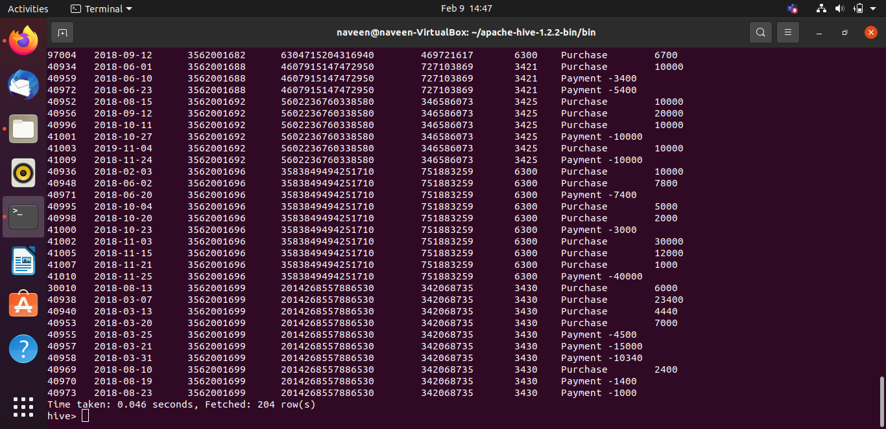
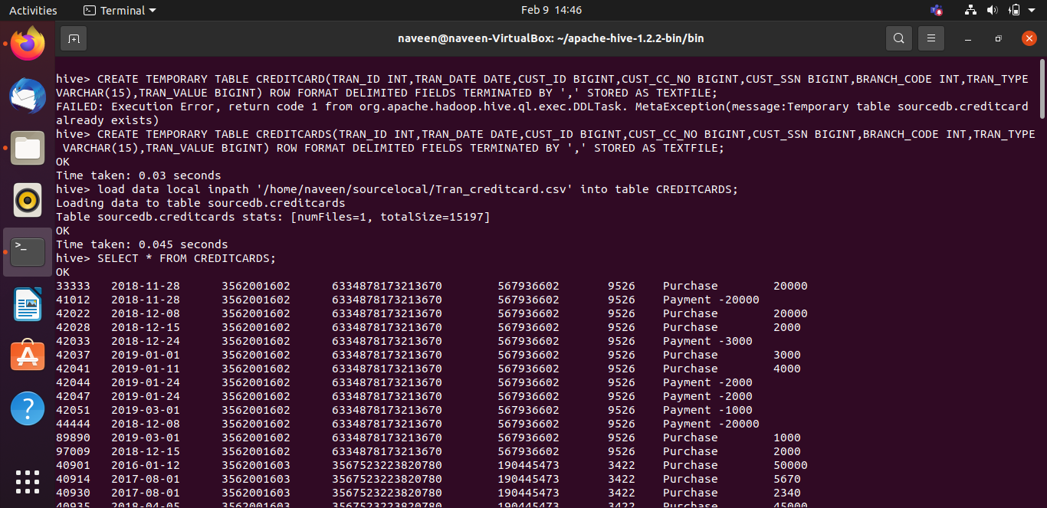

Slide 12
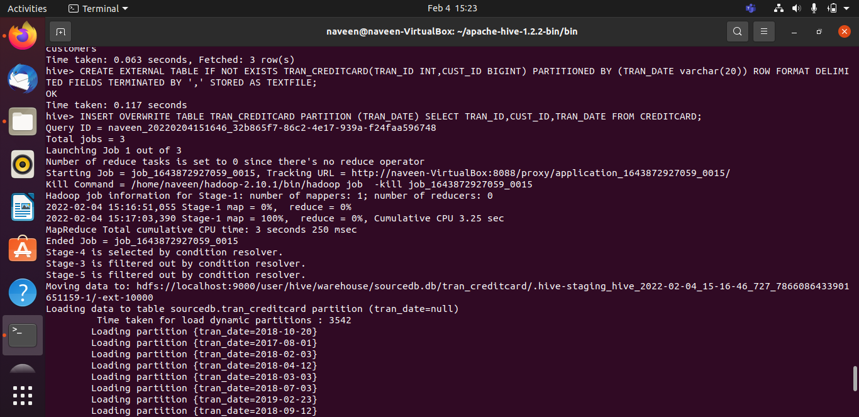
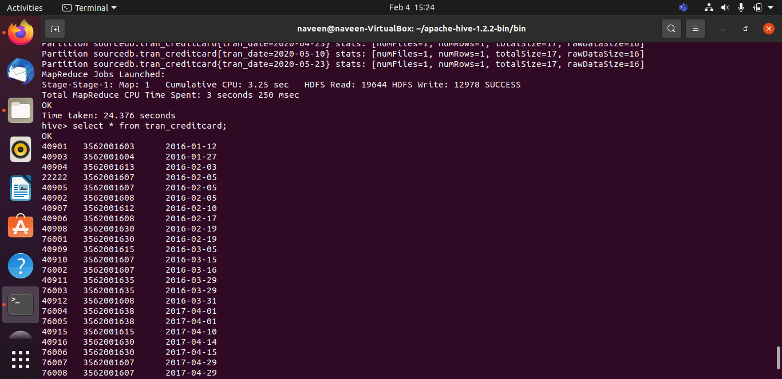

Slide 13
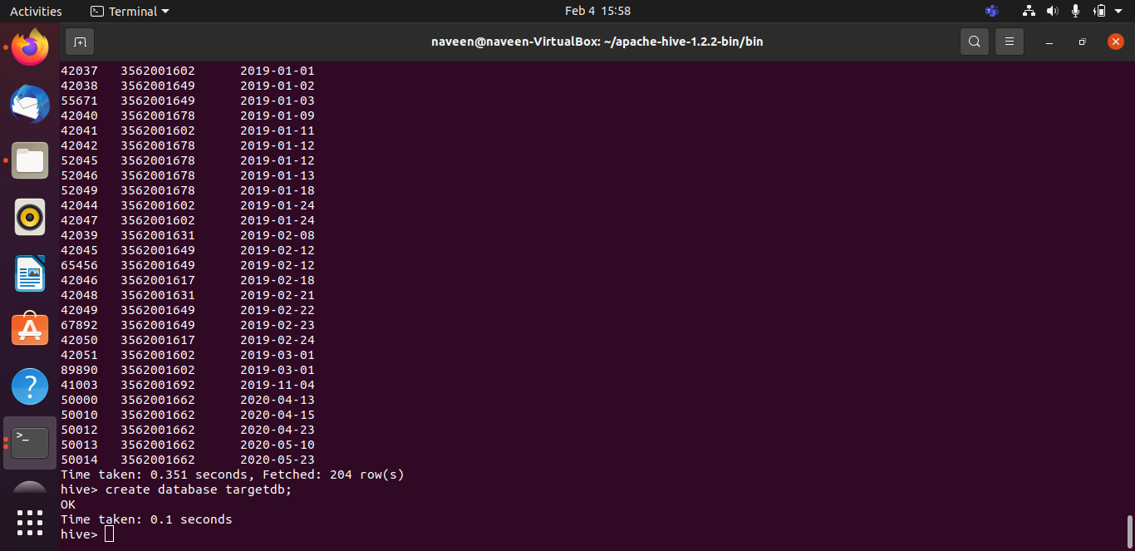
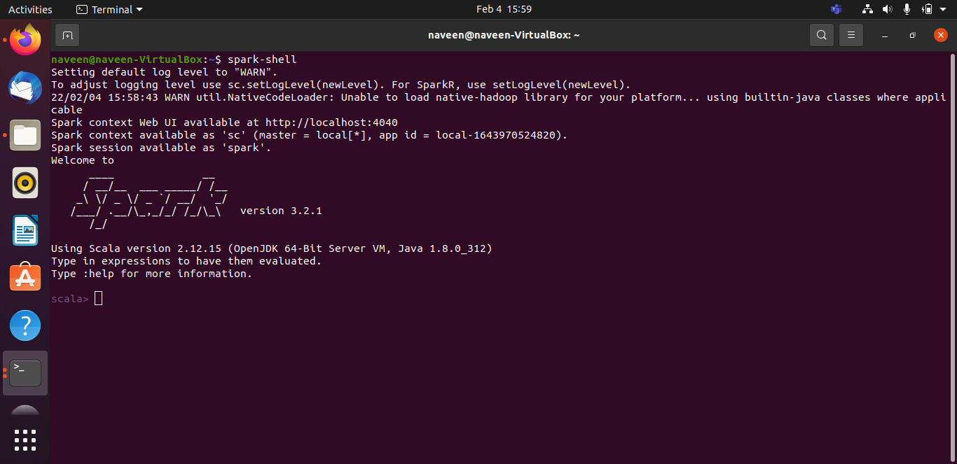

Slide 14
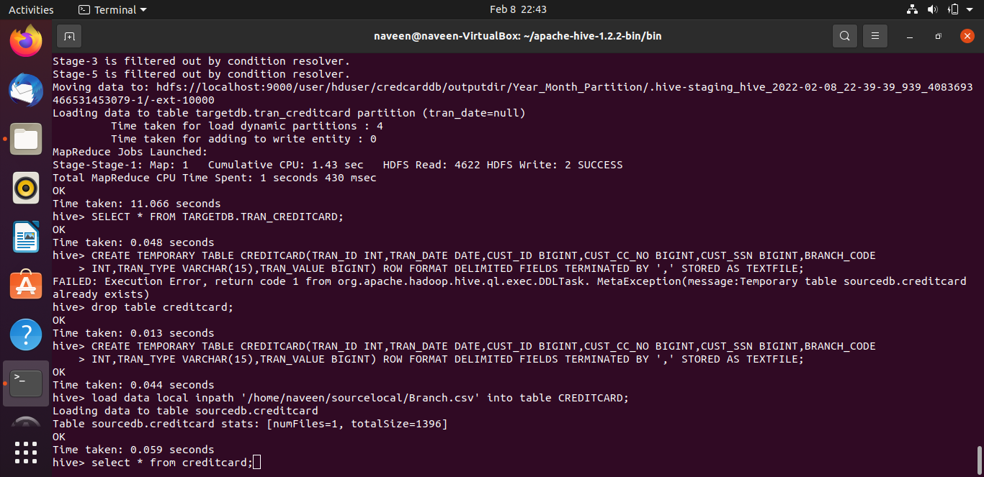
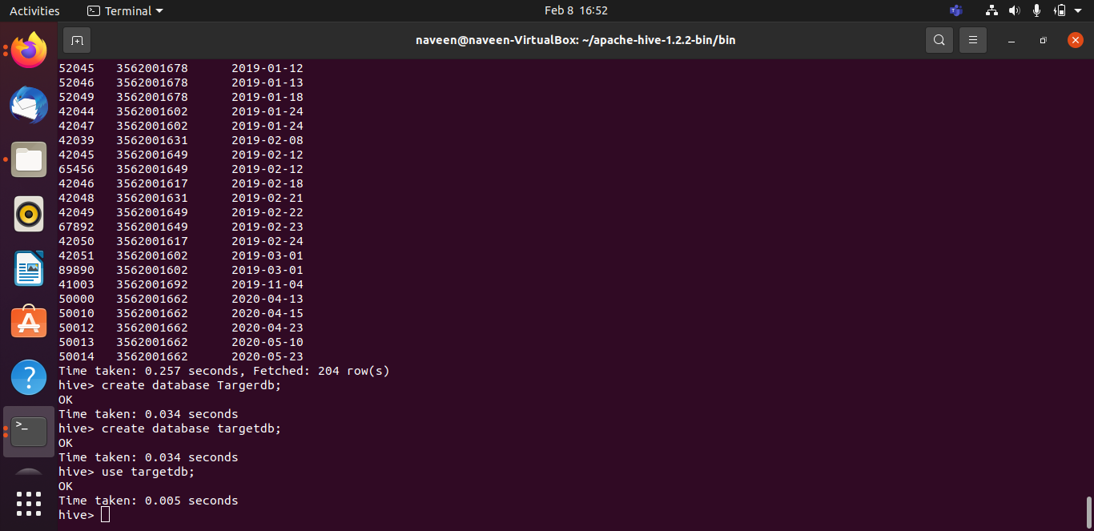
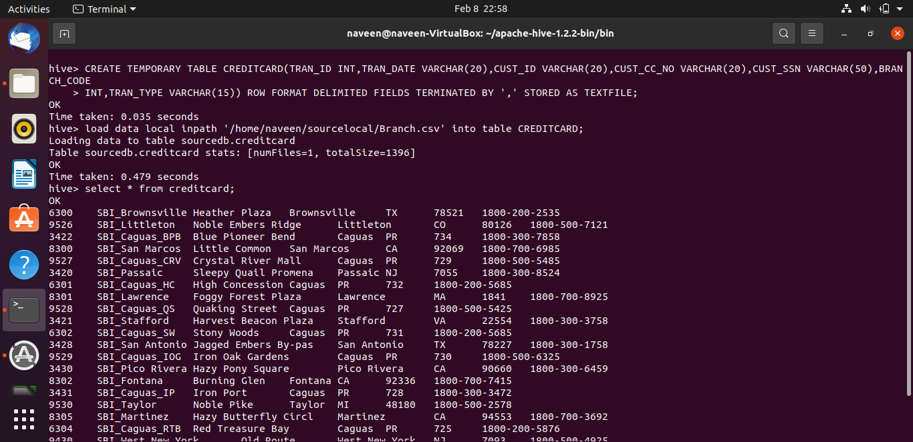

Slide 15
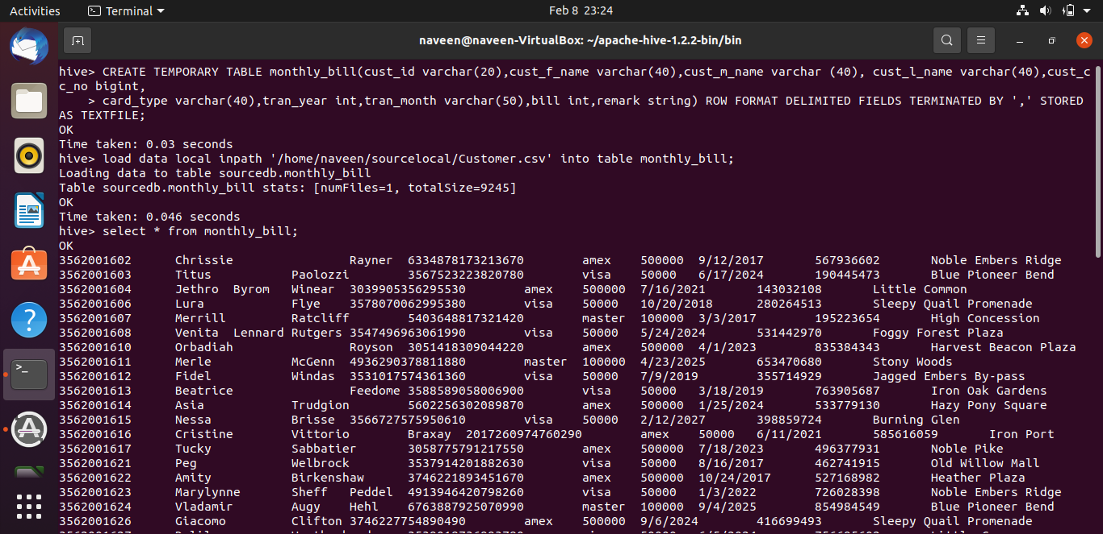
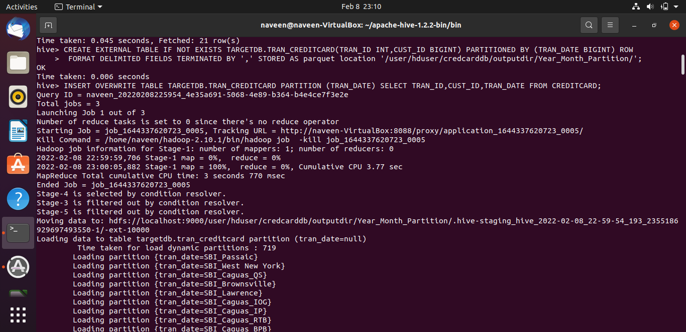
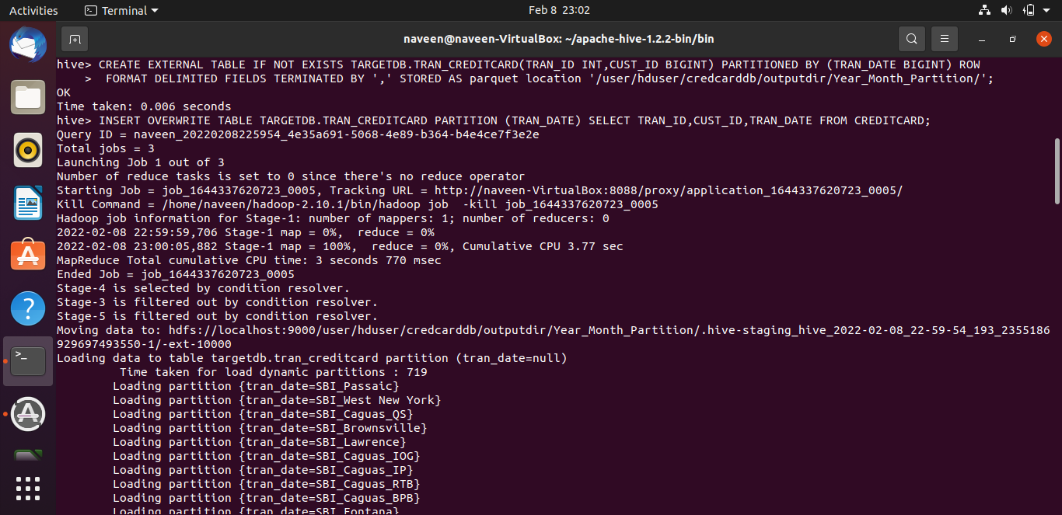

Slide 16
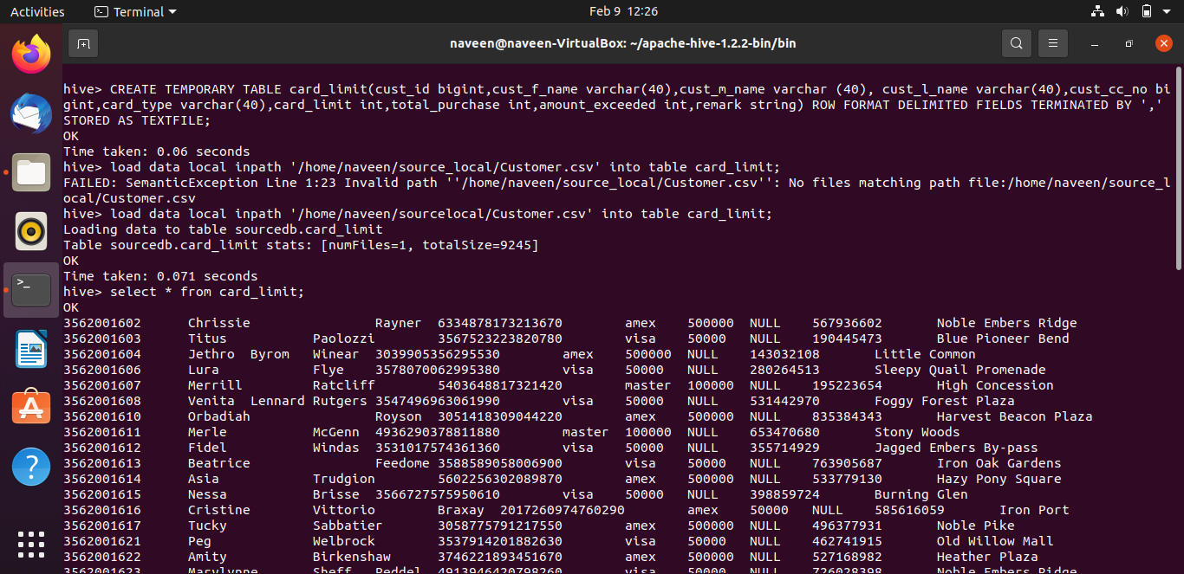
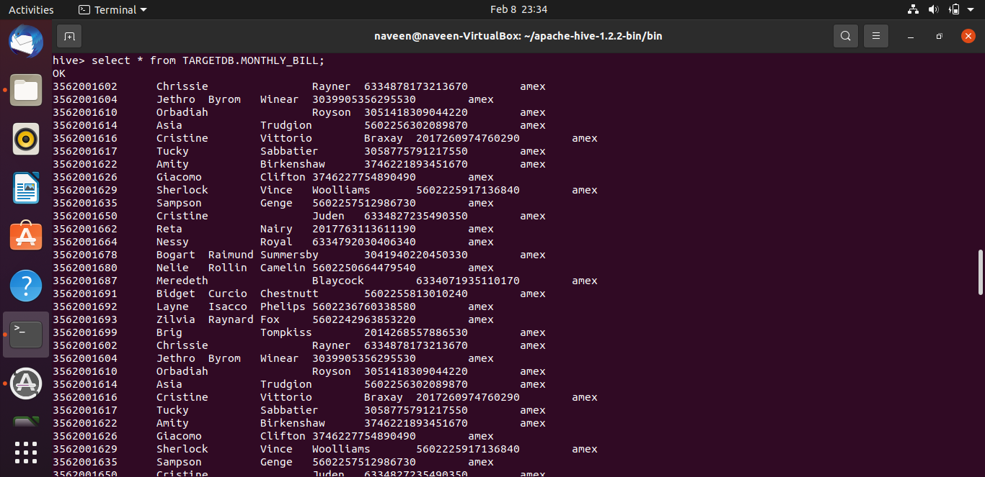
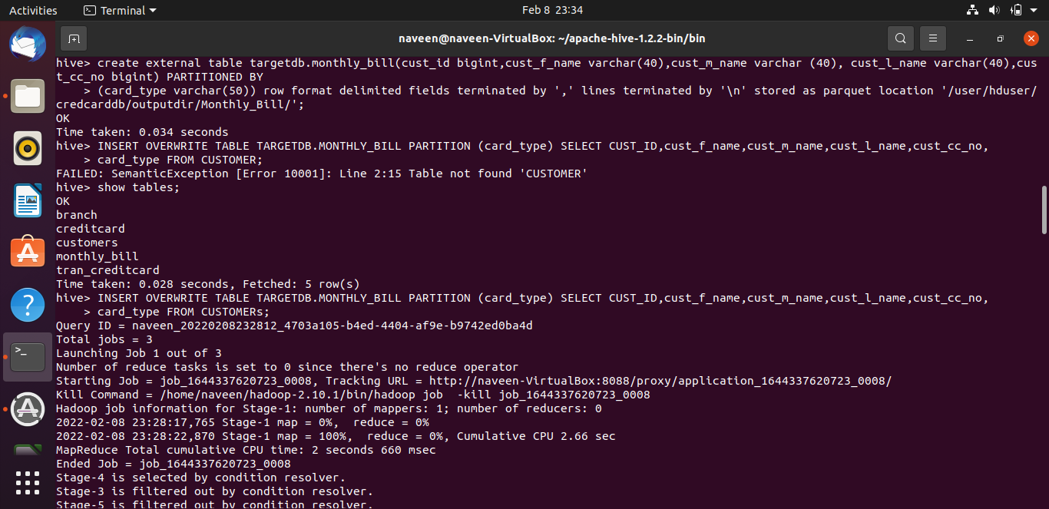

Slide 17
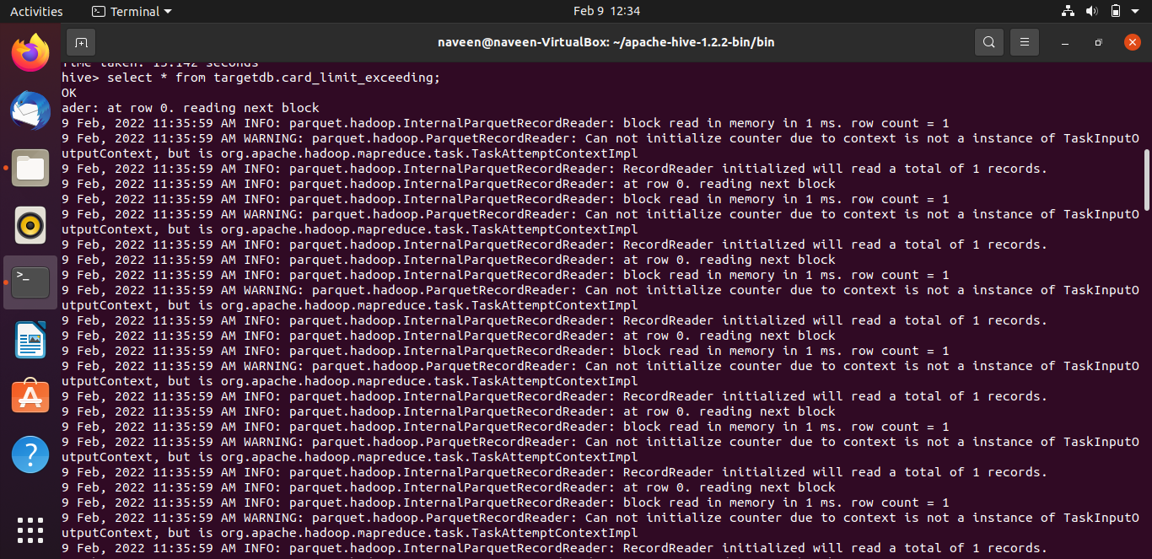
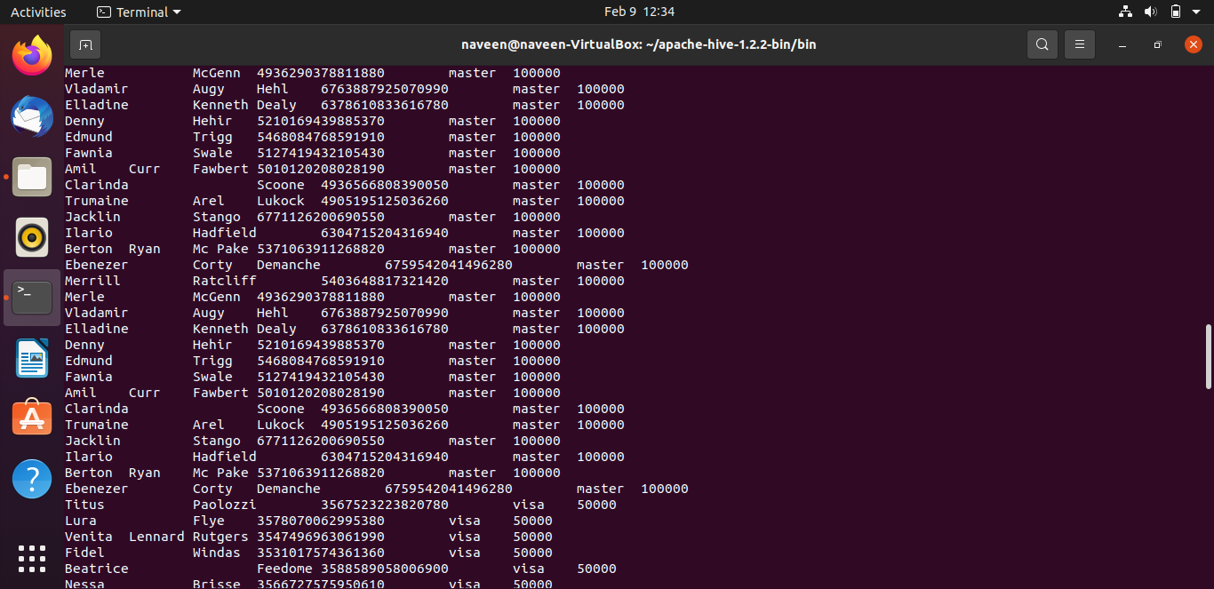
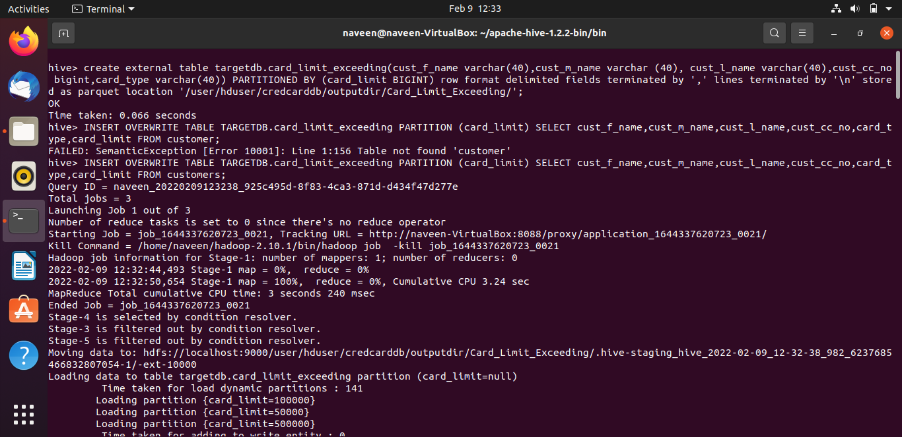

Slide 18
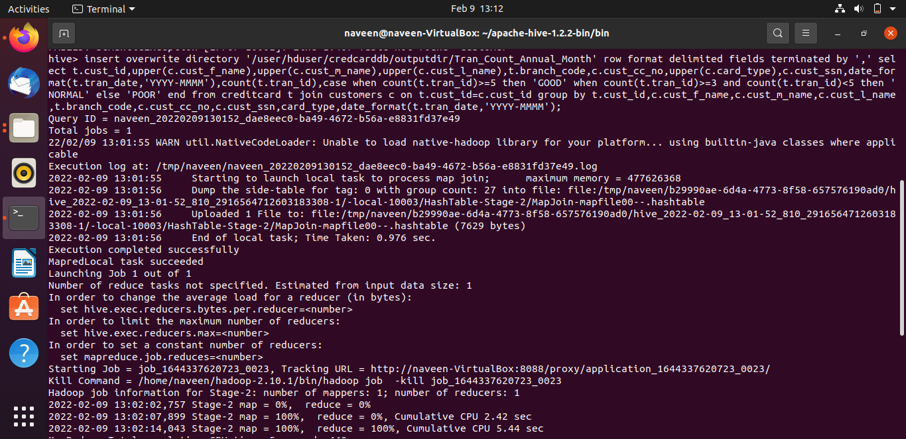
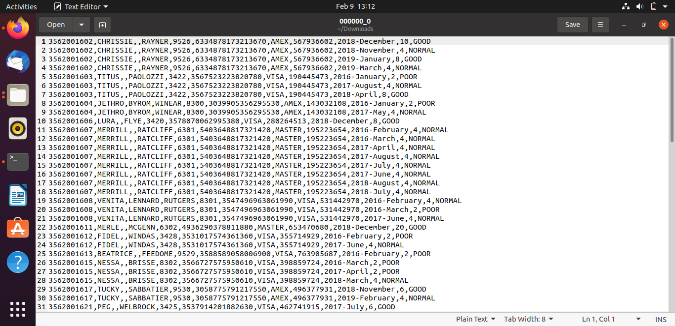
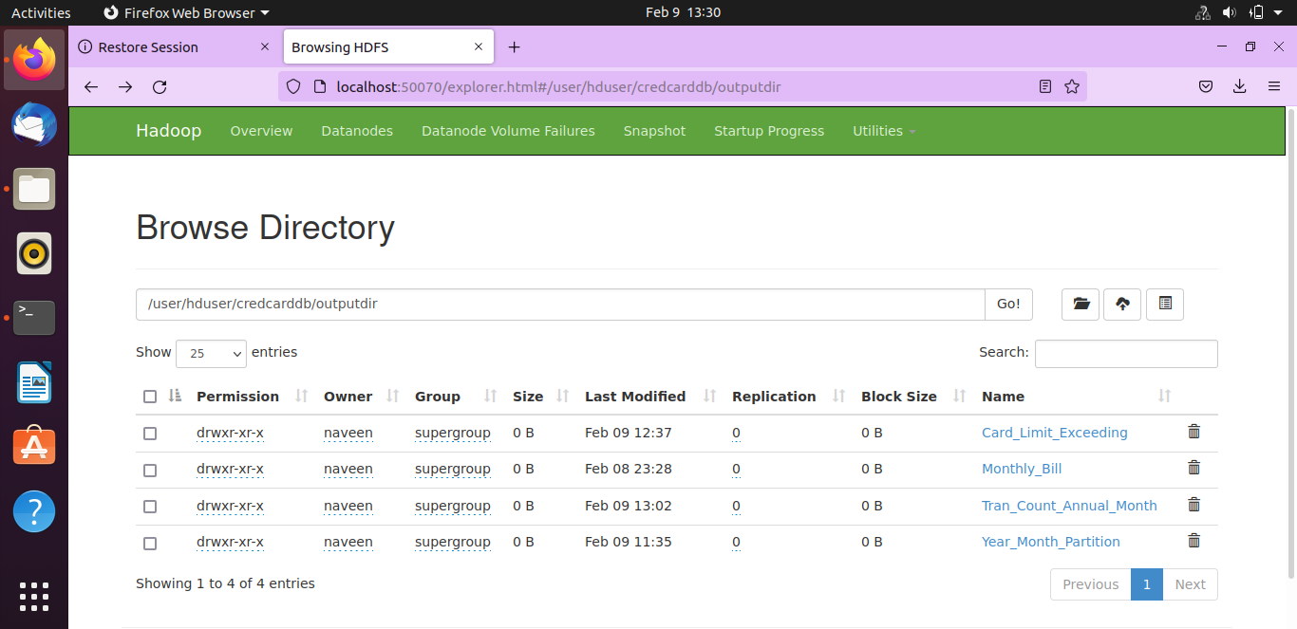

Slide 19
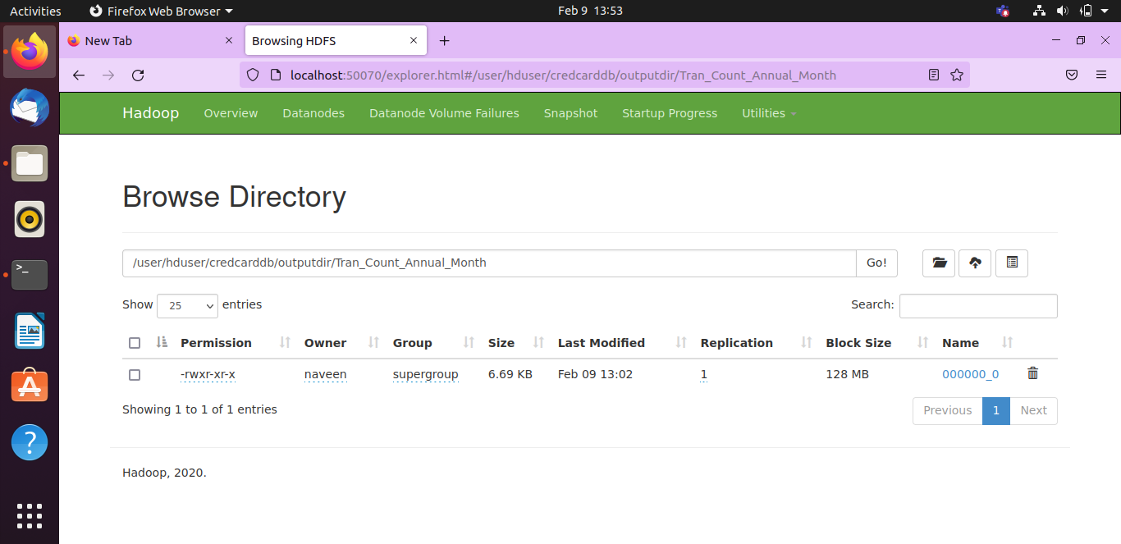
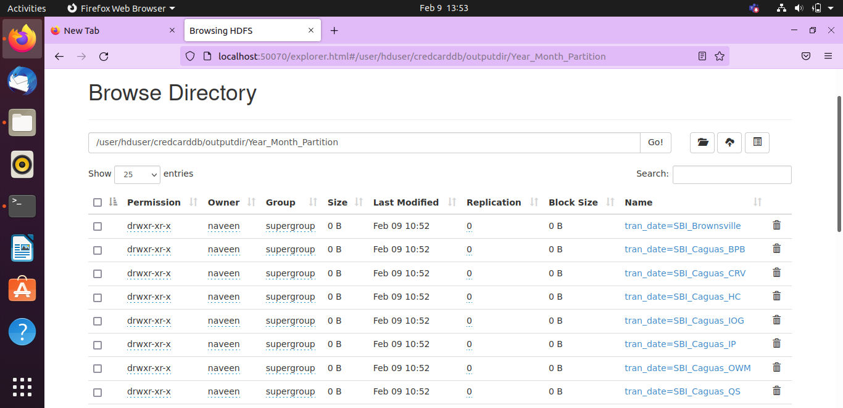

Slide 20

CONCLUSION
Observing and analyzing the trends and pattern in the customer’s transactional behavior.
We can customize offers to ensure customer satisfaction and maximize returns.
Data processing in Spark is much faster than Hive.
Hive supports partitioning to improve the performance but partitioning is suitable for only small datasets.

Slide 21
THANK YOU

